Slide 1
Aspire - Challenge 4 - Workflow
This solution implements a pizza ordering system using a microservices architecture orchestrated by Dapr Workflow and Aspire. The PizzaOrderingWorkflow drives the entire order lifecycle — from placement through cooking, validation, and delivery — coordinating five independent services via Dapr building blocks (service invocation, pub/sub, state management).

Slide 2
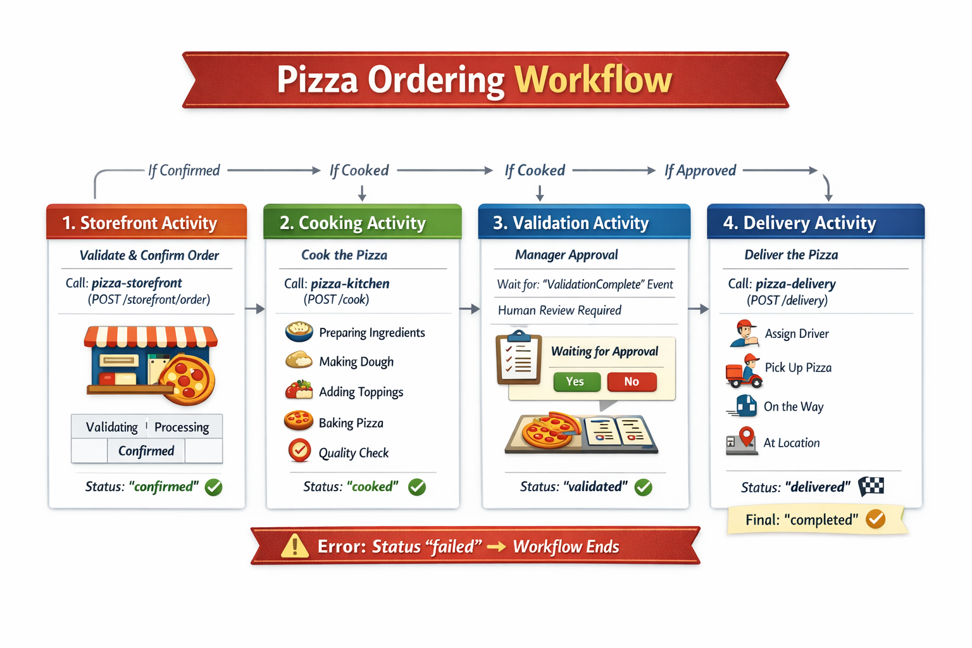
PizzaOrderingWorkflow I

Slide 3
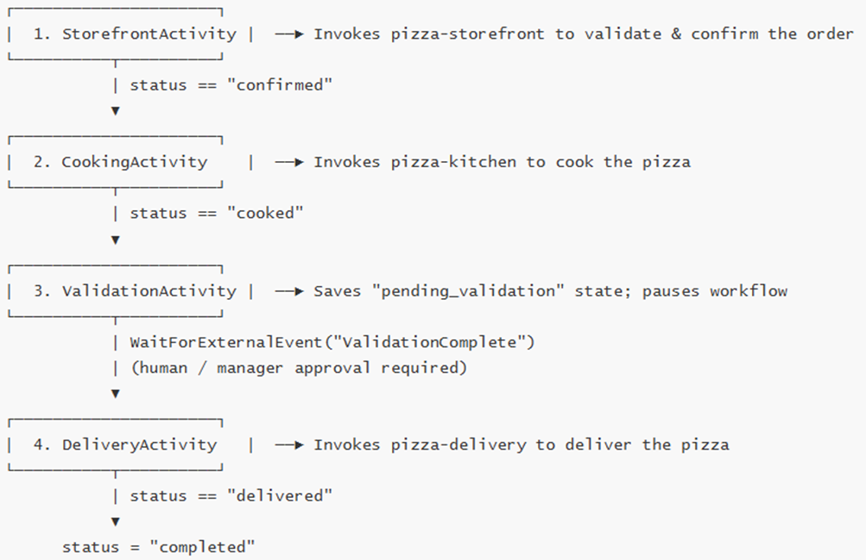
PizzaOrderingWorkflow II

Slide 4
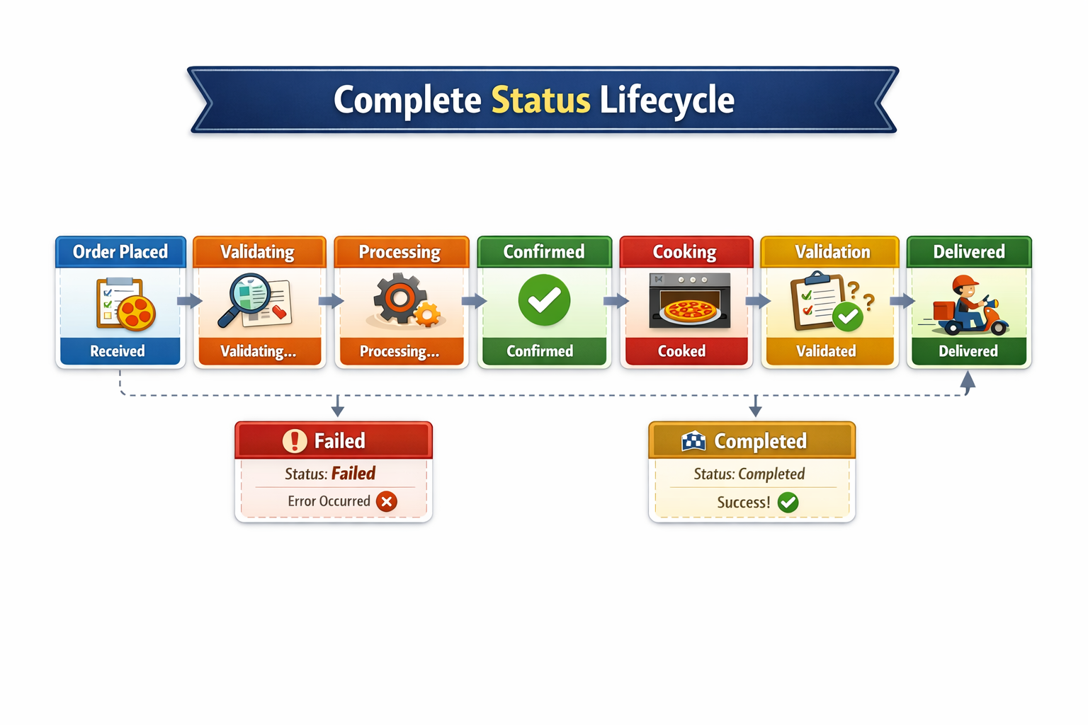
Complete Status Lifecycle I

Slide 5
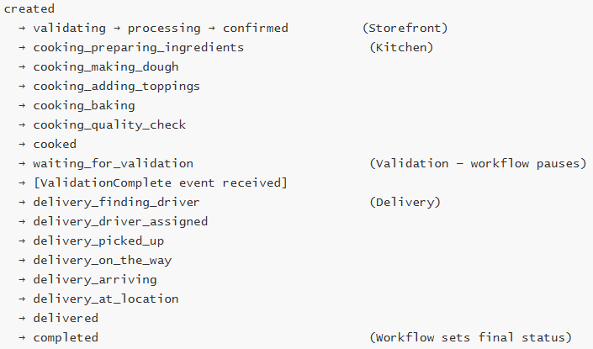
Complete Status Lifecycle II

Slide 6
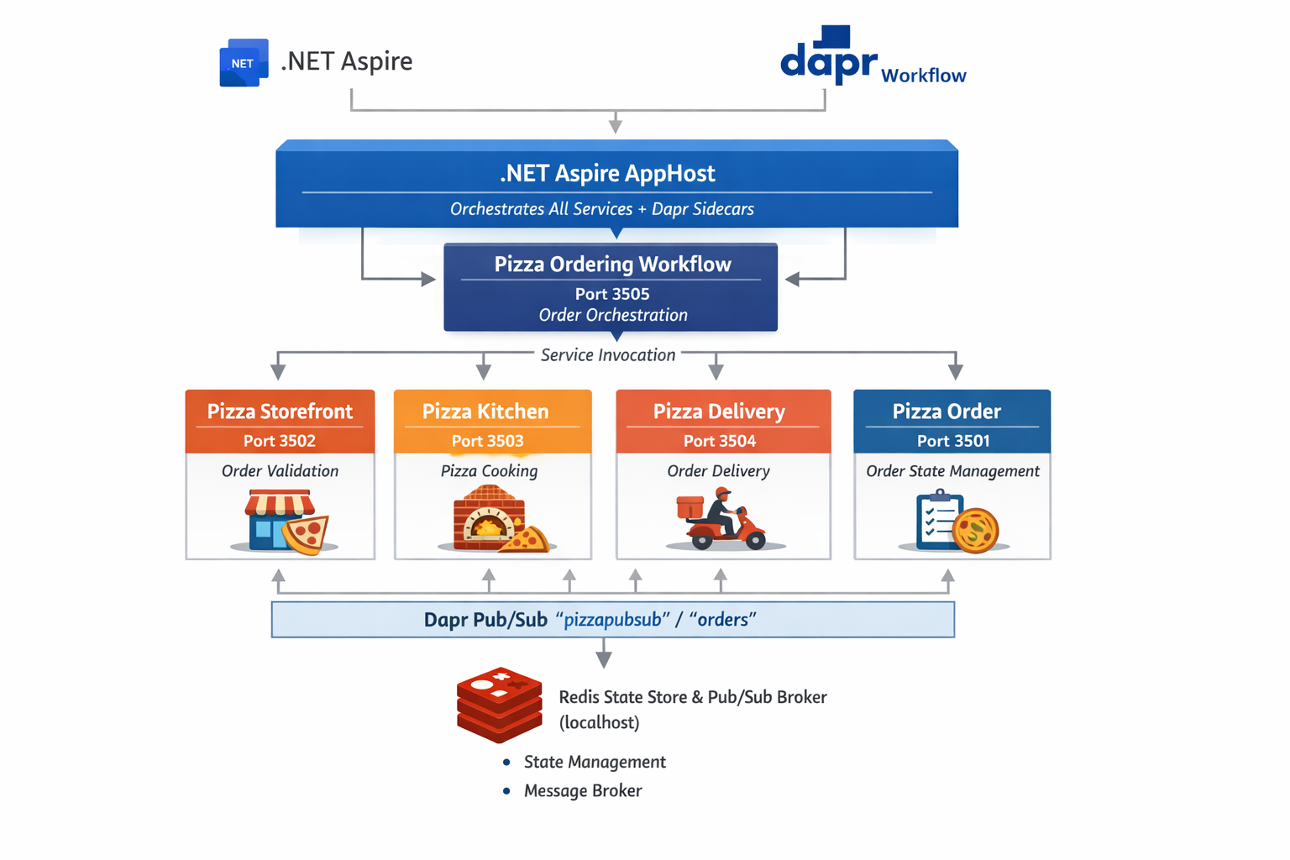
Architecture I

Slide 7
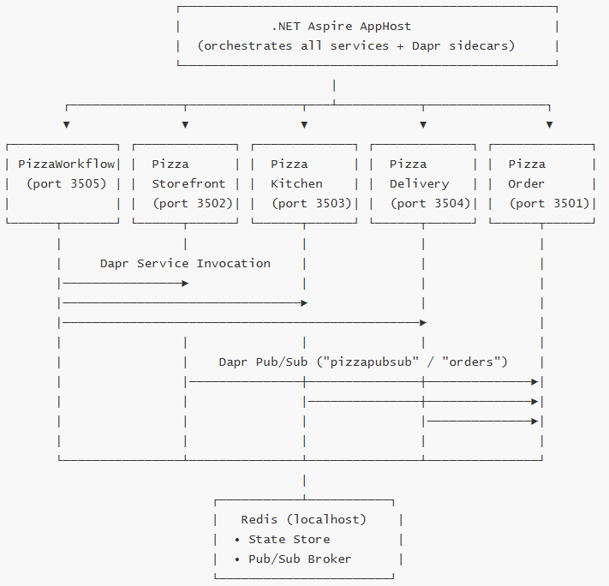
Architecture II

Slide 8
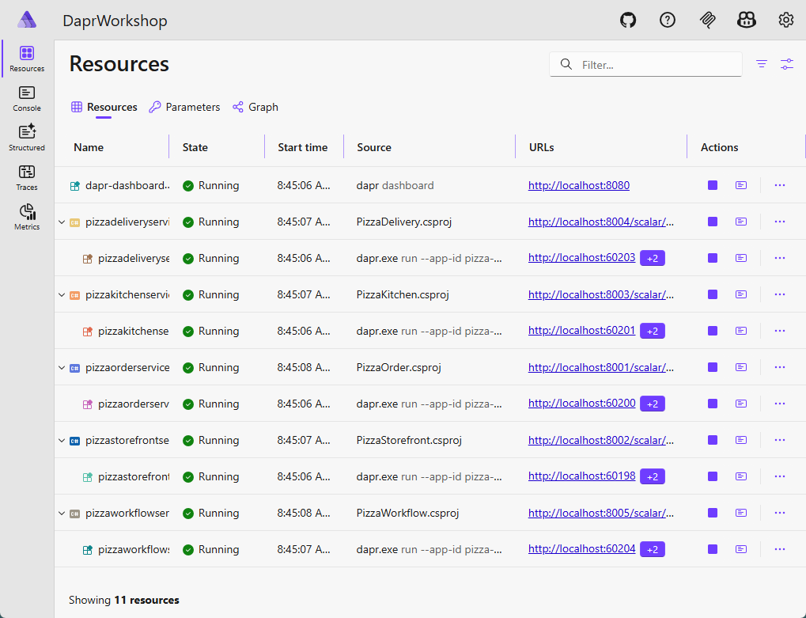

Slide 9
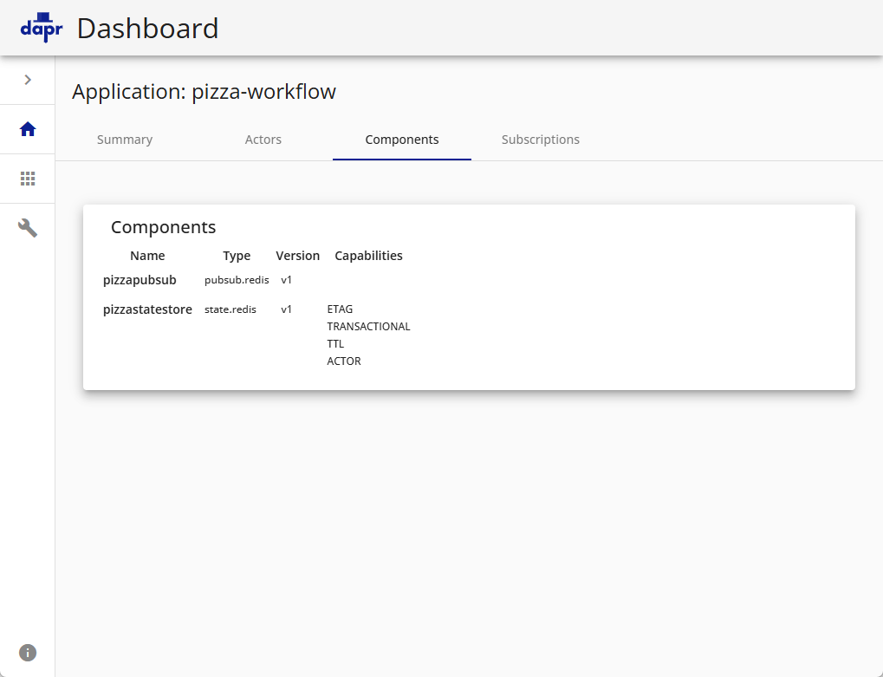

Slide 10
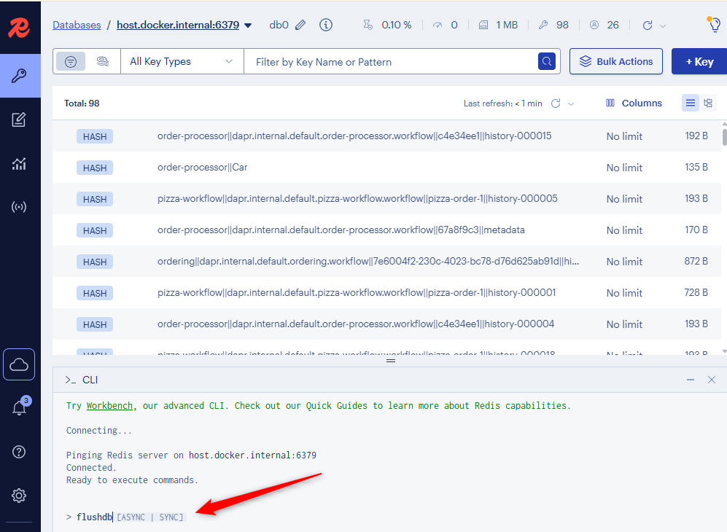

Slide 11
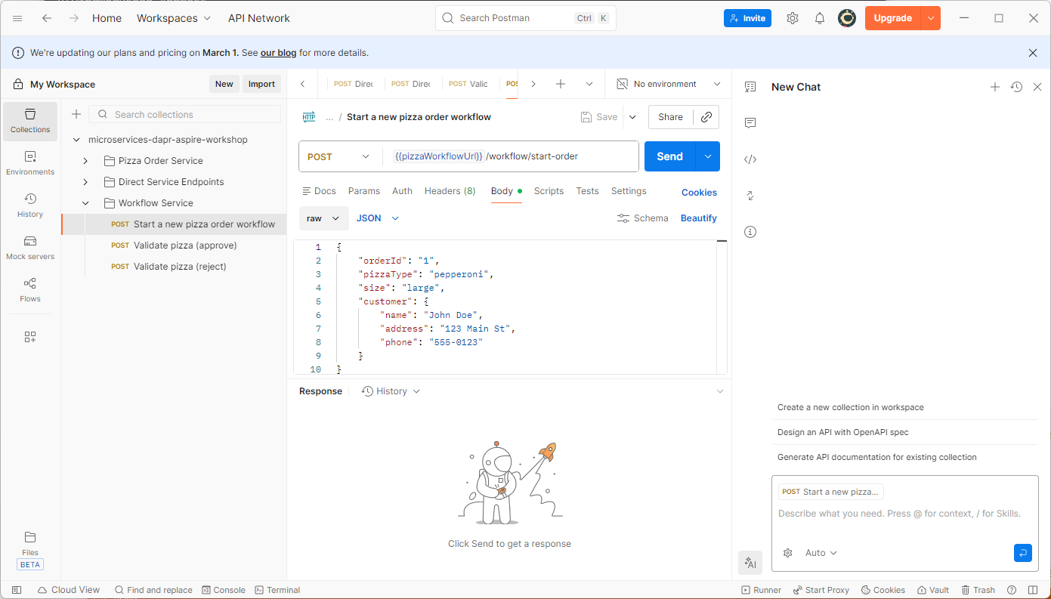

Slide 12
